Slide 1
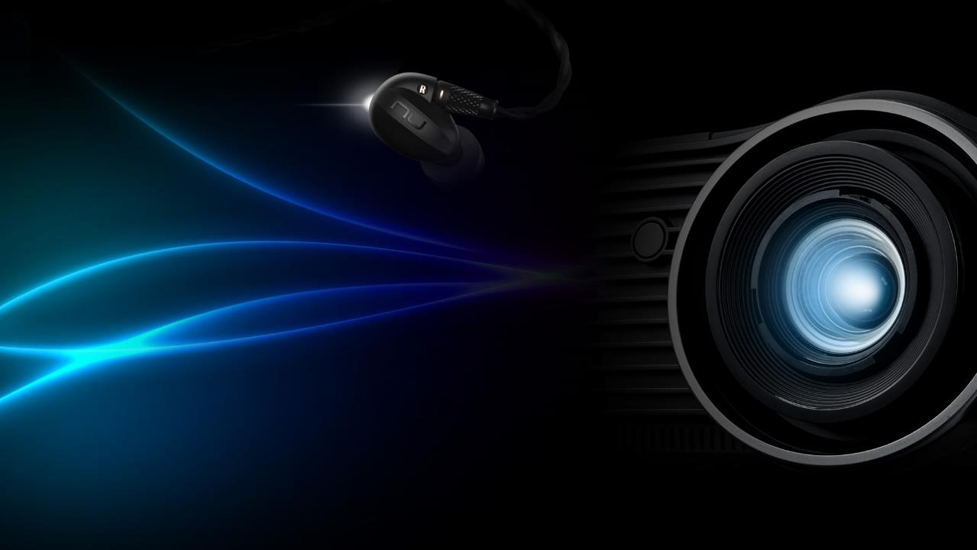
ZU506 / ZH506 Sales Kit
2019 Q 1
Training Disclaimer: This file is used for training and reference purposes only.
Please use the included information at your discretion.

Slide 2
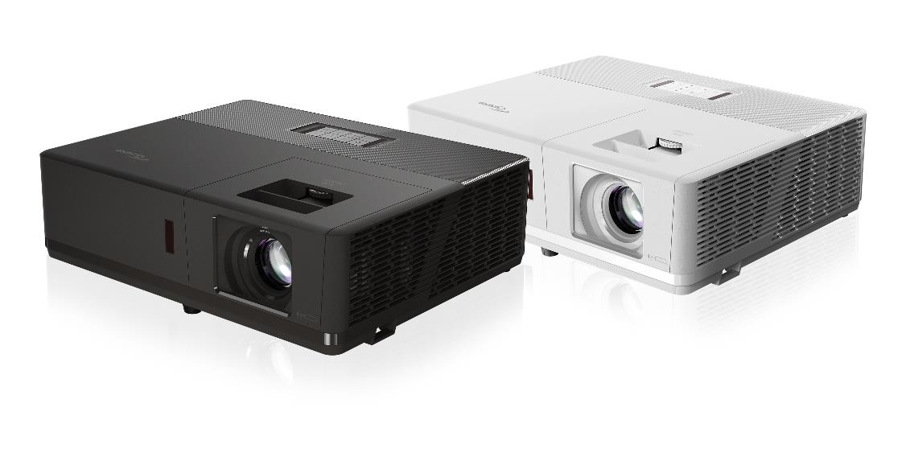

Slide 3
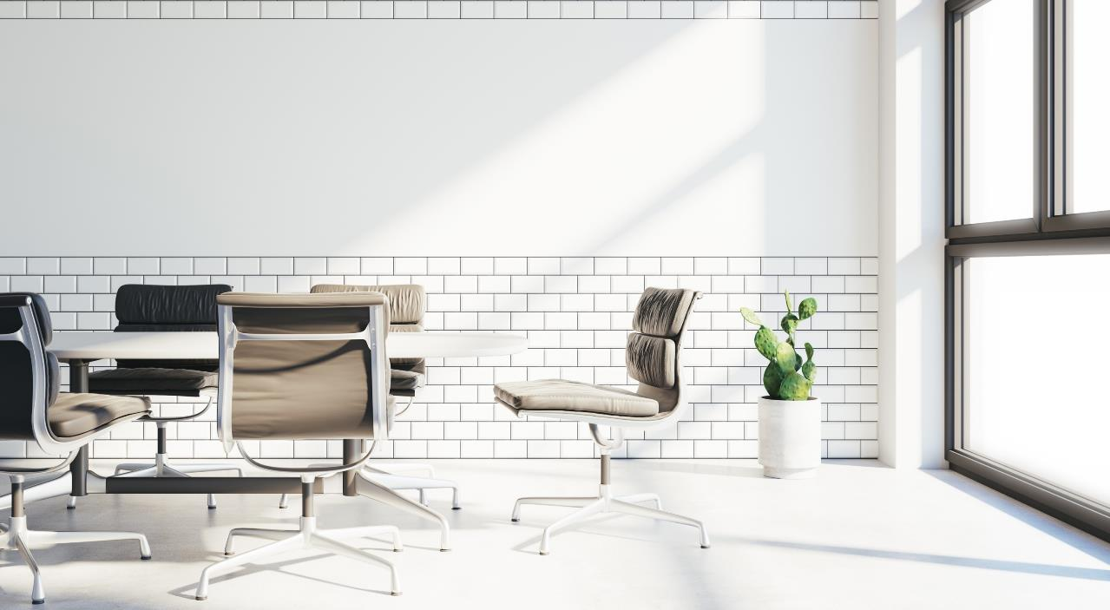
ZU506 / ZH506 Positioning
Focusing on its brightness and useful vertical lens shift, the ZU506 / ZH506 is offering best value for the entry professional installation market. The ZU506 and ZH506 are perfect for those applications that simply require the brightness level with minimum maintenance for up to 30,000 hours.

Slide 4
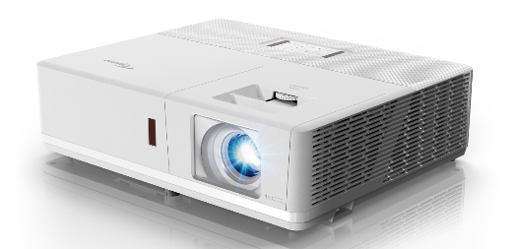
ZU506 / ZH506
Install and forget -- 30,000 hrs laser light source life and virtually zero maintenance for system
Optoma DuraCore Technology – IP5X certified system that provides great brightness maintenance & reliability
4K & HDR compatible
Amazing colors – 99% Rec.709 color gamut coverage to render lifelike images
Flexible orientation* including portrait mode
Easy installation – impressive 1.6x zoom & vertical lens shift within a compact easy to install design
Target Market
Business applications, conference rooms, higher education, houses of worship, auditoriums, museums, digital signage, exhibitions…..

Slide 5
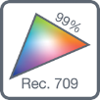
Features : ZU506 / ZH506
Optoma DURECORE
Laser Technology
Ultra bright 5,000 Lumens
300,000:1 Contrast
Airtight Optical Engine
IP5X Certified, dust resistant, high performance sealed optics
Maintenance Free
The lampless light source rated for 30,000 hours enables a low cost of ownership
Flexible Installation
Portrait Mode, Vertically up, Vertically down. (Also at any angle in-between with 70% light output and full fan setting)
Silent Operation
At 29dB, operation is quieter than a whisper
Superior Colour
99% Rec. 709 colour gamut coverage
Professional Applications
Designed for 24/7 operation, for ultimate reliability in any professional application
Vertical Lens Shift
Notes:
(已經移除PIP/PBP), 只有vertical lens shift

Slide 6
4K / HDR Compatible
ZU506 / ZH506 are capable to accept native 4K signals and compatible with HDR.
High dynamic range (HDR) technology improves contrast ratio, brightness, and color depth on the display, delivers brighter whites and deeper black levels. It enhances the details and depth of field, making the images clearer and more realistic.

Slide 7
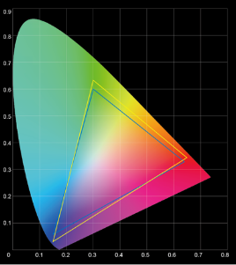
Robust & Reliable Optoma DURACORE & Amazing Colors
Optoma DURACORE
Ultimate brightness consistency and reliability
IP5X certified systems
30,000 hours or longer laser light source life
Low total cost of ownership
Optoma Amazing Colors
99% Rec. 709 coverage to render lifelike images
Optoma DURACORE
Laser Technology
ZU506 & ZH506
REC.709
99% REC.709 Coverage

Slide 8
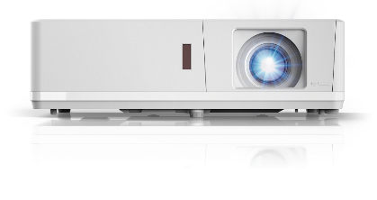
Low TCO and maintenance due to IP5X Optical Engine
The series is designed with Optoma’s Duracore Optical Engine with independently tested IP5X certification.
The engine resists dust particles and ensures a long lasting, reliable and maintenance free experience.
The Mercury free laser light source is rated for up to 30,000 hours enabling a low total cost of ownership.
Optoma Lamp-less Laser Light Source Life
Up to 30,000 hours
No maintenance
Lamp-based Light Source Life
3,000 hours
3,000 hours
3,000 hours
3,000 hours
3,000 hours
3,000 hours
3,000 hours
3,000 hours
3,000 hours
3,000 hours
Airtight Optical Engine
x 9 lamps +
x 9 labor costs +
x 9 down times
*Light source life is dependent on many factors, including display mode, usage, environmental conditions and more.
Light source brightness will decrease over time.
*30,000 hours operating in full brightness mode. At 30,000 hours, the light output will be approx. 50% of original brightness

Slide 9
Precision Optics (ZU506 / ZH506)
Big Zoom Range
Vertical Lens Shift
A large zoom range enables multiple placement possibilities at a variety of distances from the projection screen. An advantage to this is that expensive interchangeable lens projectors can be substituted with a more cost effective solution whilst still retaining a diverse choice of positioning options.
Simplify installation with lens shift, which provides a wide range of projector placement possibilities.
Vertical lens shift : ZU506 8% (99%~107%)
ZH506 15% (103%~118%)
Vs
WUXGA 8% ; 1080p 15%
1.6x
Lens shift range

Slide 10
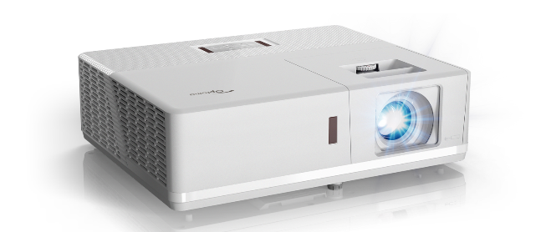
Versatile Installation
FLEXIBLE INSTALLATION
PORTRAIT MODE
Designed for Continuous
24/7 Operation
COMPACT FORM FACTOR
*50% of NEC’s PA502HL size
*62% of Sony’s VP-PHZ10 size
*65% of Epson’s PowerLite L510U size
*approximate values; for reference only

Slide 11
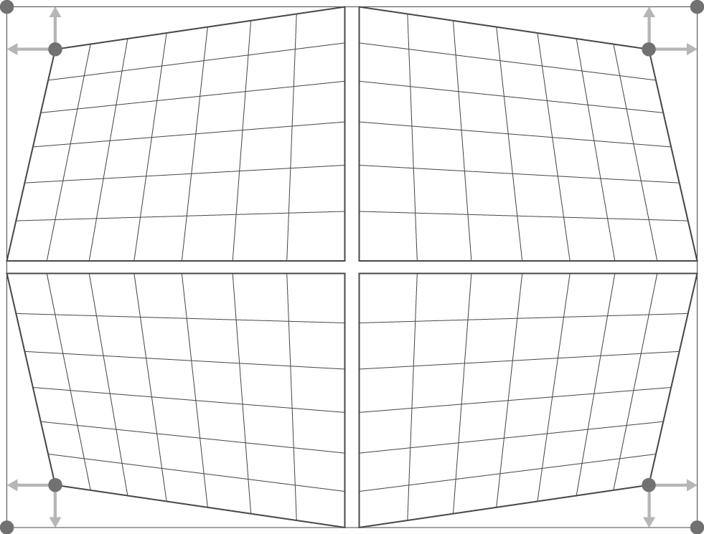
Installation Friendly
4 - Corner Adjustment
By individually adjusting each corner of the image, it eliminates any crooked or distorted images in off-angle or restricted space installations for that perfect picture.

Slide 12
Installation Friendly Highlights
Color Matching Mode
The colour matching system, combines accurate measurements across multiple projectors creates seamless blends every time.
Without color matching
With color matching

Slide 13
Network control protocols
Versatile System Integration Control Protocols Crestron RoomView, Extron’s IP Link, AMX dynamic device discovery, PJ-Link, Telnet and HTTP protocols are fully supported, allowing the series to be controlled across a network, keeping you in control, wherever you are.
AV Mute
In situations where only absolute darkness is required, the ZU506 and ZH506 series can provide a total blackout that functions like mechanical shutter. The change between normal projection to a total black image and vice versa is instantaneous.

Slide 14
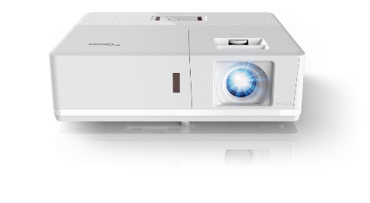
Low Noise: Quieter than a Whisper
28dB
ZU506 & ZH506
1 dB
Lowest perceivable
change in volume
10dB
20dB
Normal Breathing
30dB
Whisper
40dB
Library / Office
50dB
Outdoor Suburban
Neighborhood
WHISPER-SILENT. UNOBTRUSIVE. SUPERIOR VIEWING EXPERIENCE.

Slide 15
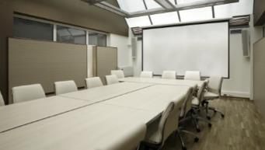
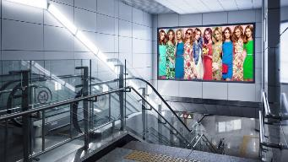
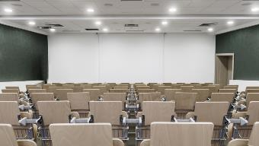
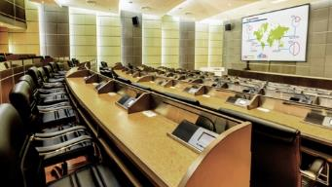
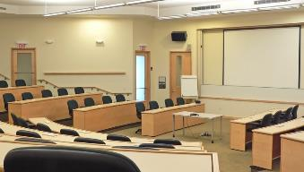
Professional Installation Applications
Delivering outstanding reliability, high intensity brightness, stunning colors and spectacular image quality, the 506 series are precision engineered to power larger than life experiences.
Optoma’s ZU506 & ZH506 are the perfect solution for businesses, museums, conference rooms, higher education, auditoriums, houses of worship, entertainment venues, projection mapping, digital signage, exhibitions.

Slide 16
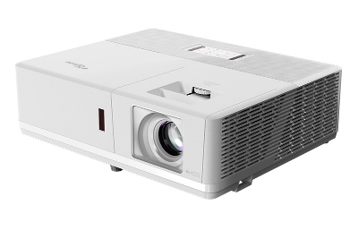
Specifications
Model | ZU506 / ZH506
Native Resolution | 1920x1200 / 1920x1080
Brightness (lm) | 5000 / 5000
Contrast | 300,000:1
Speaker | 2x 10W
Noise (Eco ) | 28dB
Weight / Size | 5.5 +-0.5 Kg / 374 x 302 x 107 mm (elevator excluded) 12.13 lb / 14.72” x 11.89” x 4.21”
Lens shift (tolerance ± 5 %) | ZU506 : V. : +8% ZH506 : V. : +15%
Throw Ratio | 1.4-2.24 / 1.4-2.24
Zoom Lens | 1.6x
Light Source Life | 30,000 hours
I/O | HDMI x1, HDMI/MHL x1, VGA in x1, VGA out x1, RS232, Audio in 1/ Mic x1, Audio in 2 x1, Audio out x1, USB Power (5V/1.5A), RJ-45, RS232
3D | Full HD 3D
Keystone correction | ±30° vertical, ±30° horizontal
Notes:
Still need update; 產品圖

Slide 17
 | Sony | NEC | Panasonic | Hitachi | Epson | Optoma
 | VPL-PHZ10 | P502HL-2 | PT-RZ570WU | LP-WU6500 | PowerLite L510U | ZU506
Avg Street Price (USD) | $3,049 | $3,099 | $4,299 | $3,599 | $2,799
MSRP (USD) | $5,000 | $5,999 | $8,999 | ** | $2,799
Brightness (lumens) | 5,000 | 5,000 | 5,200 | 5,000 | 5,000 | 5,000
Contrast (Full On/Off) | 500,000:1 | 15,000:1 | 20,000:1 | 20,000:1 | 2,500,000:1 | 300,000
Native Resolution | 1920x1200 | 1920x1080 | 1920x1200 | 1920x1200 | 1920x1200 | 1920x1200
Aspect Ratio | 16:10 (WUXGA) | 16:9 (HD) | 16:10 (WUXGA) | 16:10 (WUXGA) | 16:10 (WUXGA) | 16:10 (WUXGA)
Display Type | 0.8" 3 LCD | 0.7" 1 DLP | 0.7" 1 DLP | 1 DLP | 0.7" 3 LCD | DLP
Audible Noise | ** | 39.0 dB / 33 dB (Eco) | 33.0 dB | ** | 37.0 dB | 28db
Size (cm) (HxWxD) | 11 x 51 x 35 | 14 x 47 x 37 | 17 x 50 x 49 | 15 x 36 x 44 | 14 x 44 x 30 | 10.7 x 37.4 x 30.2
Weight | 8.7 kg | 8.8 kg | 16.3 kg | 10.5 kg | 8.5 kg | 5.5 kg
Warranty | ** | 5 Years | 3 Years | 3 Years | 3 Years
First Shipment | Jul-17 | Jun-17 | Jun-16 | Nov-17 | Aug-18 | Nov-18
Throw Dist (m) | 1.6 - 16.4 | 1.4 - 8.2 | 2.5 - 12.2 | 1.2 - 7.4 | 2.4 - 14.9 | 1.4 – 10m
Image Size (cm) | up to 300" | up to 300" | up to 388" | up to 300" | up to 500" | up to 300”
Throw Ratio (D:W) | 1.27:1 - 1.88:1 | 1.24:1 - 2.10:1 | 1.46:1 - 2.93:1 | 1.15:1 - 1.90:1 | 1.38:1 - 2.24:1 | 1.4:1 - 2.24:1
Standard Zoom Lens | Manual, 1.45:1 | Manual, 1.70:1 | Manual, 2.00:1 | Manual, 1.65:1 | Manual, 1.60:1 | Manual, 1.60:1
Standard Lens Focus | Manual | Manual | Manual | Manual | Manual | Manual
Optional Lenses | Fixed lens | Fixed lens | Fixed lens | Fixed lens | Fixed lens | Fixed lens
Lens Shift | Horiz + Vert | Horiz + Vert | Horiz + Vert | Horiz + Vert | Horiz + Vert | Vertical
Digital Zoom | Yes | ** | ** | Yes | Yes | Yes
Lamp Life (Full Power) | 20,000 hours | 20,000 hours | 20,000 hours | 20,000 hours | 20,000 hours | 30,000 hours
Lamp Life (ECO) | 20,000 hours | 20,000 hours | 20,000 hours | 20,000 hours | 30,000 hours | 30,000 hours
Lamp Type | Laser Phosphor | Laser Phosphor | Laser Phosphor | Laser Phosphor | Laser Phosphor | Laser Phosphor
Speakers | ** | 20.0W Mono | x | 10.0W Mono | 10.0W Mono | 10W x2
3D Modes | ** | Full HD 3D | ** | Full HD 3D | ** | Full 3D
Power Usage | 424W | 464 Watts | ** | 460 Watts | 353 Watts | Typ 310, Max 341
HDMI | 2 | 2 | 2 | 3 | 2 | 2
HDBase T | 1 | 1 | 1 | 1 | 1 | x
VGA / RGB In | 1 | 1 | 2 | 1 | 1 | 1
VGA / RGB Out | x | 1 | 1 (shared with VGA-in) | 1 | 1 | 1
Wired Networking | 1 | 1 | 1 | 1 | 1 | 1
DVI | x | x | 1 | x | x | x
Audio In | 2 | Yes | Yes | Yes | Yes | Yes
Audio Out | 1 | 1 | 1 | 1 | 1 | 1
12-Volt Trigger | x | x | x | x | x | x
USB | USB-A x1 (for wireless dongle) USB-B x1 (for USB Display) | USB-A x1 | USB-A x1 (for power, 5V 0.9A) | USB-A x1 (for power, 5V 1.5A) USB for service x1 | USB-A x1 USB-B x1 | USB-A x1
RS232 | 1 | 1 | 1 | 1 | 1 | 1
Composite | 1 | 1 | 1 | 1 | x | 1
3D Sync | x | 1 | x | 1 | x | x

Slide 18
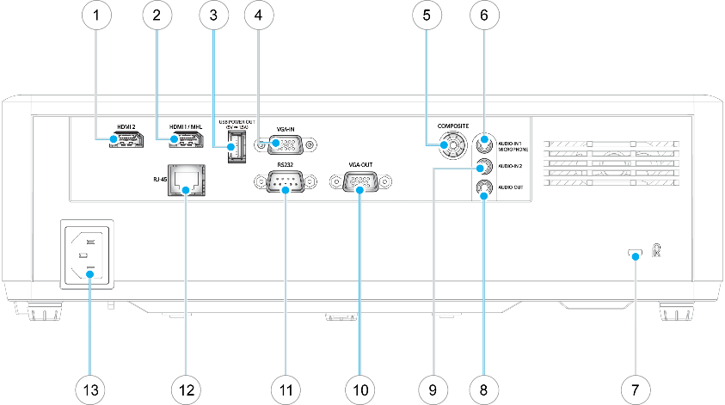
I/O
HDMI 2
HDMI 1/ MHL
USB A for power (5V, 1.5A)
VGA in
Composite
Audio in 1 / Mic
Kensington Lock
Audio out
Audio in 2
VGA out
RS232
RJ45
Power Socket
Notes:
Already updated

Slide 19
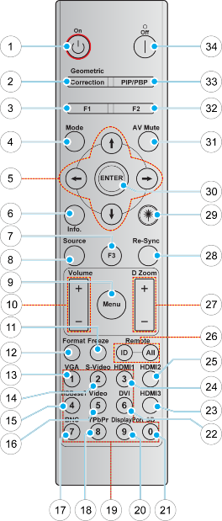
Remote
Power On
Geometric Correction
Function button F1 (assignable)
Mode
Four Directional Select Keys
Information
Function button F3 (assignable)
Source
Menu
Volume +/-
Freeze
Format
VGA
S-Video (not supported)
HDBaseT (SKU dependent)
Video
BNC (not supported)
YPbPr (not supported)
Numeric keypad
Display port (not supported)
3D
DVI (not supported)
HDMI3 (not supported)
HDMI1
HDMI2
Remote ID / Remote all
Digital zoom +/-
Resync
Laser (not supported)
Enter
AV Mute
Function button F2 (assignable)
PIP/PBP (not supported)
Power off
Note: Some keys may have no function for models that do not support these features.

Slide 20
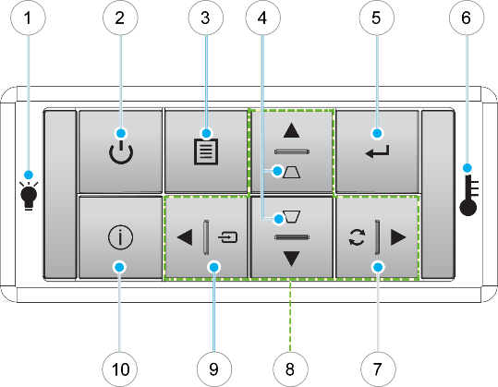
Keypad
Lamp LED
Power and Power LED
Menu
Keystone Correction
Enter
Temp LED
Re-Sync
Four Directional Select Keys
Source
Information

Slide 21
Features Overview: ZU506 / ZH506
Standard Features |  |  | Additional Features
DLP Technology | √ |  | Full HD 1080p | √ |  | LED Technology | - |  | Crestron | √ |  | Blending Mode | -
BrilliantColor | √ |  | HD Ready | - |  | LED+ Technology | - |  | PJ Link | √ |  | Media Player | -
Full 3D | √ |  | Dynamic Black | √ |  | Laser Technology | √ |  | Telnet | √ |  | Four Corner Adjustment | √
3D Ready | - |  | 24p | √ |  | Integrated Speaker | √ |  | Extron | √ |  | HDBaseT | -
High Contrast | √ |  | Gaming Mode | √ |  | ProCinema Sound | - |  | LAN Display | √ |  | Dual Lamp | -
Top Loading Lamp | - |  | Superwide Mode | - |  | SRS WOW HD | - |  | Wireless - WPS | - |  | Lamp Relay | -
Sleep Timer | √ |  | Ultra-Wide Projection | - |  | TouchBeam Interactive | - |  | Wireless - USB Dongle | - |  | Lamp Pulsing | -
Direct Power On | √ |  | PureMotion | - |  | IR Pen Interactive | - |  | Wireless - WHD200 | √ |  | Edge Blending Tools | -
Direct Power Off | √ |  | UltraDetail | - |  | 12V Trigger | - |  | MHL | √ |  | Black Level Uplift | -
 |  |  | PureColor | - |  | Short Throw | - |  | Remote Mouse | - |  | Image Stacking | -
Eco Features |  |  | HDMI Link | √ |  | Ultra Short Throw | - |  | Remote Mouse & Laser | - |  | Interchangeable CW | -
Eco+ | - |  | 2D-3D Conversion | - |  | Vertical Lens Shift | √ |  | USB Display | - |  | PiP / PbP | -
Quick Resume | - |  | CMS | - |  | Full Lens Shift | - |  | USB Reader | - |  | Wire Remote | -
Eco AV mute | √ |  | ISF modes | - |  | Motorized Lens Shift | - |  | USB-A Power | √ |  | DICOM Simulation Mode | √
Image Life | - |  | DARBEE | - |  | Motorized Zoom & Focus | - |  | Signal Power On | √ |  | Mechanical Shutter | -
Lamp SPA | - |  | REC.709 Color | √ |  | PureShift | - |  | Logo Capture | √ |  | Portrait Projection | √
Education Cycle | - |  | Audio EQ Presets | - |  | RS232 | √ |  | Digital Signage Mode | - |  | Flexible Projection | √
Auto Power Off | √ |  | ProConnect | - |  | AMX | √ |  | Auto Keystone | √ |  | 24/7 Operation | √
 |  |  |  |  |  | Networking | √ |  | Horizontal Keystone | √ |  | HDMI EQ | -

Slide 22
Thanks for your attention!

